Slide 1
Flight Fare Prediction using Flask
A Web App for Predicting Flight Prices
Presented by

Slide 2
Introduction
Airfare prices fluctuate regularly due to factors like demand, seasonality, competition, and economic conditions.
Travelers face challenges in identifying the right time to book flights for the best deal.
Predicting flight prices is complex due to the variability in influencing factors.
Machine learning can help predict airfare trends based on historical data and market analysis.
This project aims to develop a Flight Fare Predictor using machine learning models to forecast flight prices.
The project integrates Flask, a web framework, to create a user-friendly interface for interacting with the predictor.
The system analyzes historical pricing data and trends, helping users decide the optimal time to book flights.
By leveraging machine learning and web development, the goal is to simplify the flight booking process and provide actionable insights for users.

Slide 3
Objective
Build an intuitive web application to predict flight prices for users.
Provide a user-friendly platform for travelers to easily access fare predictions and insights.
Integrate accurate machine learning models to forecast flight prices based on historical data and trends.
Create a predictive model using various machine learning algorithms, including:
Linear Regression
Random Forest Regression
XGBoost Regression
K-Nearest Neighbors (KNN)
LightGBM (LGBM)
Evaluate and compare the performance of these models to ensure accurate flight price predictions.

Slide 4
Technology Stack
Frontend: HTML, CSS, JavaScript
Backend: Flask (Python)
ML Models: Random Forest, XGBoost, Linear Regression, KNN, LightGBM
Tools: Figma, Jupyter

Slide 5
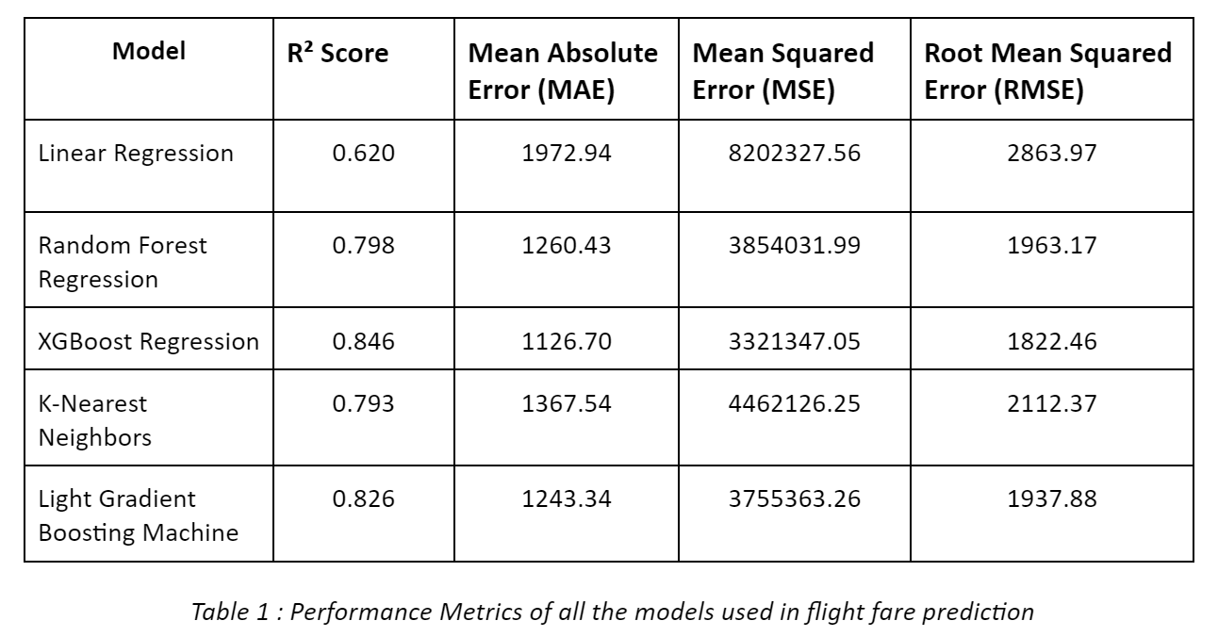
Machine Learning Models
Models used: Random Forest, XGBoost, Linear Regression, KNN, LightGBM
Best model: XGBoost with lowest RMSE.

Slide 6
Data Preprocessing
Handling missing values, feature scaling, and splitting data.
Selected features like Airline, Source, Destination, Date of Journey.

Slide 7
Web Application Features
Landing page: Home Page of the Flight Price Predictor.
Prediction page: Display fare predictions based on inputs.
Input fields include:
Source City: The city from which the flight will depart.
Destination City: The city to which the flight is headed.
Departure Date: The date of the outbound flight.
Arrival Date (optional): The date of the return flight if applicable.
Stopage: The number of travelers.
Airline Type: Air India, Indigo.
Prediction Page:
Based on the inputs, the app displays fare predictions for the selected route and date.

Slide 8
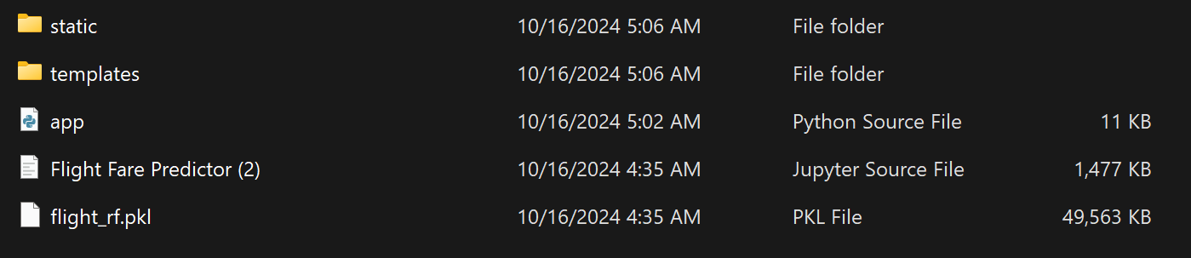
Flask Integration
Flask handles HTTP requests and integrates ML models.
Static files for CSS, images, and templates for HTML.

Slide 9
Deployment
Version control with GitHub.

Slide 10
Conclusion
Web app successfully predicts flight fares.
XGBoost model performed best. Future improvements possible.

